Slide 1
Chapter 15
High Availability and Disaster recovery

Slide 2
High Availability
Load Balancing
Spread workload
Most common for servers
Different Techniques
Round Robin, Affinity, Weighted, etc
Multipathing
Multiple paths between a system and its storage
Systems Must have multiple NIC’s
NIC Teaming
Multiple Network interfaces teamed up for bandwidth aggregation and/or traffic failover
Notes:
Multipathing: provides a backup path in case the preferred connection goes down; connects each NIC to its own switch
NIC teaming: provides Load Balancing Fail Over, redundant paths and combines bandwidth, very useful in the cloud or when using virtual systems
Multiple physical NICs that act as one massive NIC; they send multicasts messages to each other

Slide 3
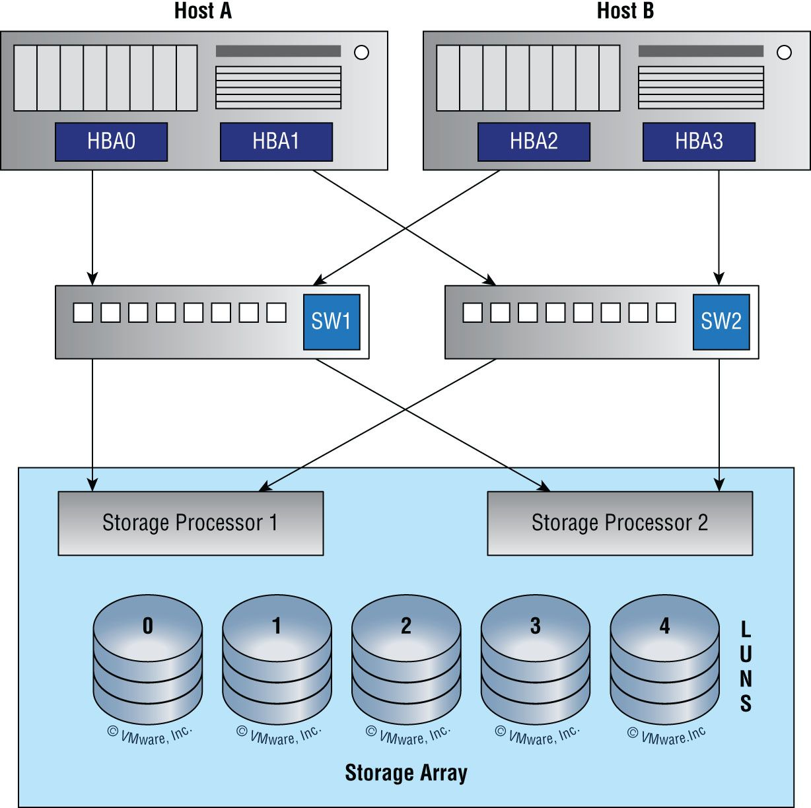
Multipathing
3
Notes:
Host A and Host B have multiple NICs and multiple connections through multiple switches and are mapped to multiple storage processors as well
High fault-tolerance

Slide 4
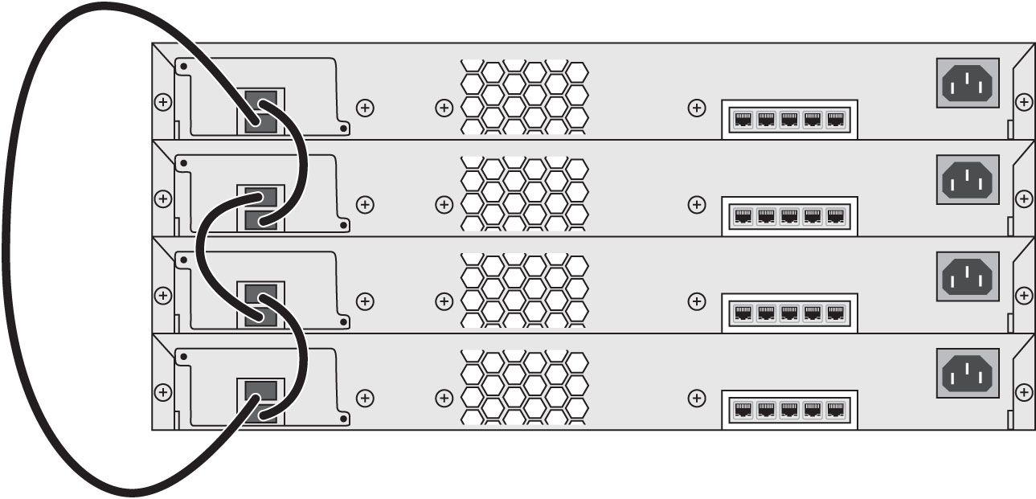
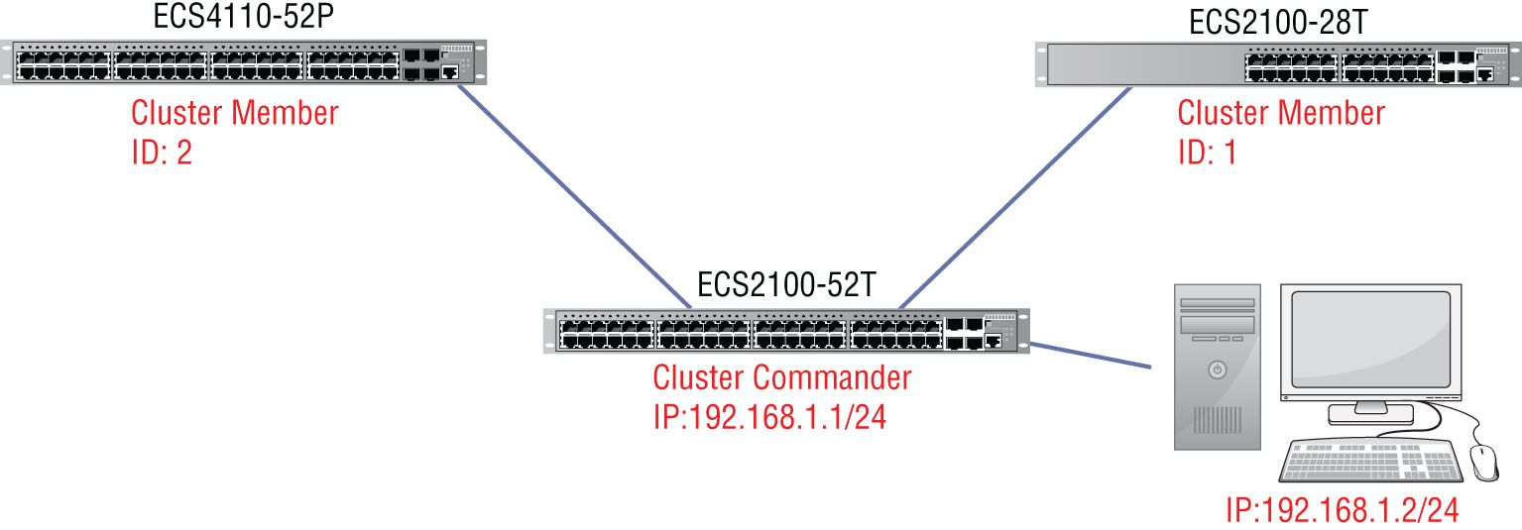
Redundant Hardware/Clusters
Switches
Switch Stacking
stack and interconnect multiple switches to act as one switch
One switch is designated the management switch
Switch Clustering
Managed as a single entity with interconnected cables
Uses Cluster Management Protocol (CMP)
Configure and troubleshoot a group of switches with a single ip Address
Cluster Commander, Cluster member
Notes:
Switch stacking: process of connecting multiple switches together and managing them as a single switch
Layer 2 and layer 3 protocols present the entire stack as a single entity to the network
Has one active switch and one standby switch
Switch Clustering: set of connected and cluster-capable switches that managed as a single entity without stack cables
Uses CMP (Cluster Management Protocol)
One switch plays the role of cluster command switch, and the other switches are cluster member switches managed by the command switch

Slide 5
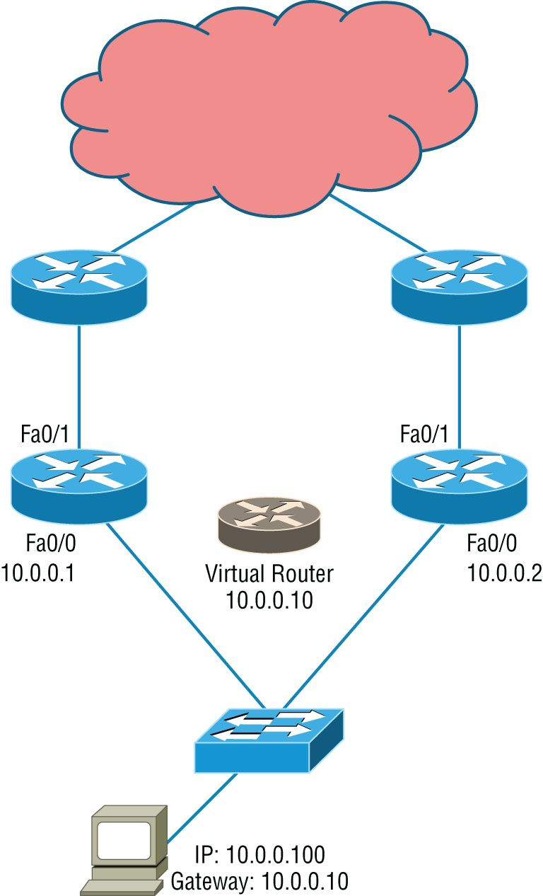
Redundant Hardware/Clusters
Routers
First Hop Redundancy Protocol
Firewalls
Notes:
Provides first-hop redundancy; gives you a way to configure more than one physical router to appear as if it were a single logical one

Slide 6
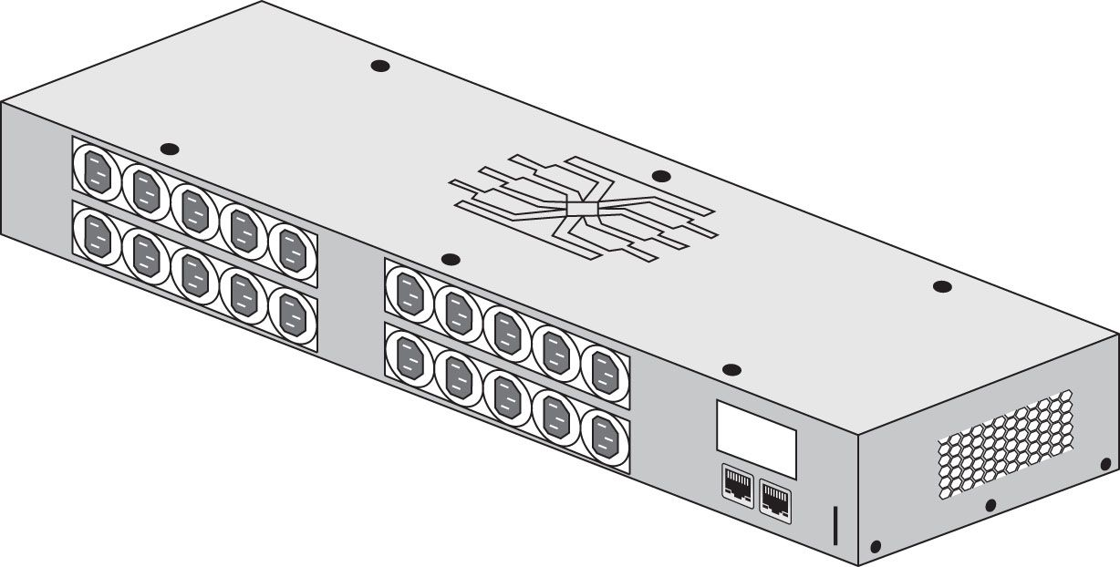
Facility and Infrastructure Support
Uninterruptible power supply (UPS)
Power Distribution units (PDU)
Generator
HVAC
Fire Suppression
Notes:
UPS: short-term backup power
PDU: means of distributing power from the input to a plurality of outlets
Includes circuit breakers and power monitoring panels
Generator: long-term backup power; amount of backup time supplied is limited only by the amount of fuel you keep on hand
HVAC: support the maintenance of computing equipment and infrastructure devices, integrate it into the fire system
Fire suppression: fire extinguishers, wet pipe systems, dry pipe systems, etc

Slide 7
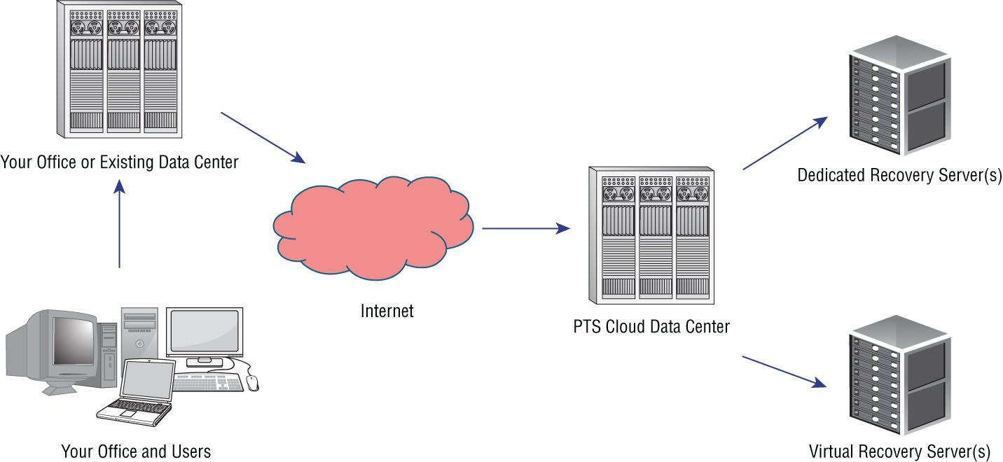
Redundancy and High Availability (HA)
Hot Site
Cold Site
Warm Site
Cloud Site
Recovery site provisioned through a CSP
Notes:
Hot site: quickest recovery, most expensive, always ready to go
Cold site: Only contains electrical and communication wiring, AC, plumbing, and raised flooring; slowest recovery, but the cheapest
Warm site: In between the hot and cold site, widely implemented
Cloud site: an extension of cloud backup services; sites that mimic your on-premises network

Slide 8
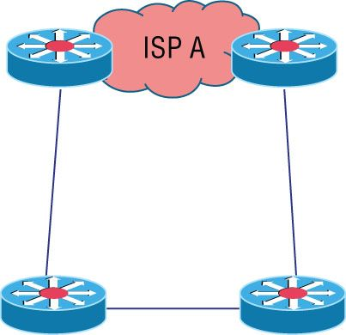
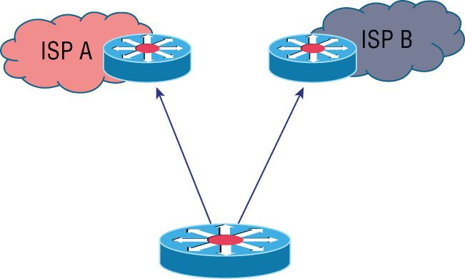
Redundancy and High Availability (HA)
Active/Active
Provides availability
Active/Passive
Provides Fault tolerance
Multiple ISP’s/Diverse Paths
Notes:
Multiple ISP’s/Diverse paths: Protect against a single ISP failure by setting up a path to each from a single router

Slide 9
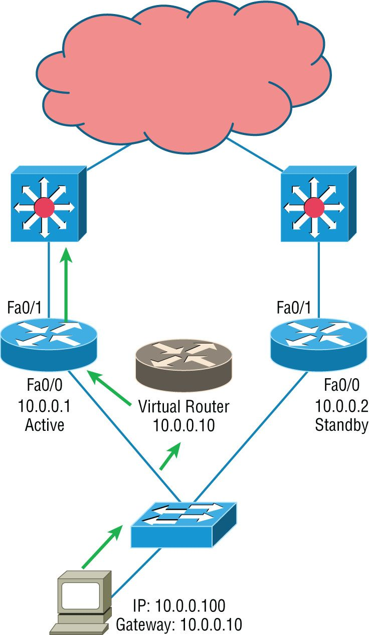
Redundancy and High Availability (HA)
Hot Standby Router Protocol (HSRP)
Cisco Protocol
Virtual Router Redundancy Protocol(VRRP)
IEEE protocol
Notes:
HSRP: defines a standby group, and each standby group that you define includes an active router, a standby router, a virtual router, and any other routers that may be attached to the subnet
Problem is only one router is active and you have two or more routers in standby mode, which isn’t cost effective
VRRP: has one master router and one or more backup routers and it’s the open standard version of HSRP

Slide 10
Redundancy and High Availability (HA)
Mean Time to Repair (MTTR)
Used to draft SLA’s
Average time it would take to repair a system
Mean Time Between Failures (MTBF)
Reliability metric
Amount of time elapsed from one failure to the next
Recovery Time Objective (RTO)
Period of time after a failure or disaster that a resource or function must be restored to avoid unacceptable losses
Recovery Point Objective (RPO)
Moment in time after a failure or disaster the data must be recovered to
Drives backup frequency
Notes:
MTTR: Time it takes to fix an issue
MTBR: Time between outages, how long will a system be up before a failure occurs again
RTO: getting up and running to a particular service level
RPO: how much data needs to be available before we’re back up and running

